Slide 1
Database System
Lecture 8

Slide 2
Normal Forms in DBMS
Normalization is the process of minimizing redundancy from a relation or set of relations.
Redundancy in relation may cause insertion, deletion, and update anomalies. So, it helps to minimize the redundancy in relations.
Normal forms are used to eliminate or reduce redundancy in database tables.

Slide 3
Normalization of DBMS
In database management systems (DBMS), normal forms are a series of guidelines that help to ensure that the design of a database is efficient, organized, and free from data anomalies.
There are several levels of normalization, each with its own set of guidelines, known as normal forms.

Slide 4
Important Points Regarding Normal Forms in DBMS
First Normal Form (1NF): This is the most basic level of normalization. In 1NF, each table cell should contain only a single value, and each column should have a unique name. The first normal form helps to eliminate duplicate data and simplify queries.
Second Normal Form (2NF): 2NF eliminates redundant data by requiring that each non-key attribute be dependent on the primary key. This means that each column should be directly related to the primary key, and not to other columns.
Third Normal Form (3NF): 3NF builds on 2NF by requiring that all non-key attributes are independent of each other. This means that each column should be directly related to the primary key, and not to any other columns in the same table.
Boyce-Codd Normal Form (BCNF): BCNF is a stricter form of 3NF that ensures that each determinant in a table is a candidate key. In other words, BCNF ensures that each non-key attribute is dependent only on the candidate key.

Slide 5
Important Points Regarding Normal Forms in DBMS
Fourth Normal Form (4NF): 4NF is a further refinement of BCNF that ensures that a table does not contain any multi-valued dependencies.
Fifth Normal Form (5NF): 5NF is the highest level of normalization and involves decomposing a table into smaller tables to remove data redundancy and improve data integrity.
Normal forms help to reduce data redundancy, increase data consistency, and improve database performance. However, higher levels of normalization can lead to more complex database designs and queries. It is important to strike a balance between normalization and practicality when designing a database.

Slide 6
Advantages of Normal Form
Reduced data redundancy: Normalization helps to eliminate duplicate data in tables, reducing the amount of storage space needed and improving database efficiency.
Improved data consistency: Normalization ensures that data is stored in a consistent and organized manner, reducing the risk of data inconsistencies and errors.
Simplified database design: Normalization provides guidelines for organizing tables and data relationships, making it easier to design and maintain a database.
Improved query performance: Normalized tables are typically easier to search and retrieve data from, resulting in faster query performance.
Easier database maintenance: Normalization reduces the complexity of a database by breaking it down into smaller, more manageable tables, making it easier to add, modify, and delete data.

Slide 7
First Normal Form
If a relation contain composite or multi-valued attribute, it violates first normal form or a relation is in first normal form if it does not contain any composite or multi-valued attribute.
A relation is in first normal form if every attribute in that relation is singled valued attribute.
Every table should have primary key and relationship between the table should be formed using foreign key.
Example 1: Relation STUDENT in table 1 is not in 1NF because of multi-valued attribute STUD_PHONE. Its decomposition into 1NF has been shown in table 2.

Slide 8
First Normal Form
Example 1: Relation STUDENT in table 1 is not in 1NF because of multi-valued attribute STUD_PHONE. Its decomposition into 1NF has been shown in table 2.
Table 1: Student
STUD_NO | STUD_NAME | STUD_PHONE | STUD_CITY
1 | Humair | 0333-876542, 0306-8869890 | Karachi
2 | Ali | 0300-7872892 | Islamabad
3 | Hira | 0333-8876789 | Lahore
Table 2: Student
STUD_NO | STUD_NAME | STUD_PHONE | STUD_CITY
1 | Humair | 0333-876542, | Karachi
1 | Humair | 0306-8869890 | Karachi
2 | Ali | 0300-7872892 | Islamabad
3 | Hira | 0333-8876789 | Lahore

Slide 9
Second Normal Form
It’s already in 1NF
It has no partial dependency. That is, all non-key attributes are fully dependent on a primary key.

Slide 10

Example
Imagine we're building a restaurant management application. That application needs to store data about the company's employees and it starts out by creating the following table of employees:

Slide 11
Example of Second Normal Form (2NF)
All the entries are atomic and there is a composite primary key (employee_id, job_code) so the table is in the first normal form (1NF).
But even if you only know someone's employee_id, then you can determine their name, home_state, and state_code (because they should be the same person). This means name, home_state, and state_code are dependent on employee_id (a part of primary composite key). So, the table is not in 2NF. We should separate them to a different table to make it 2NF.

Slide 12
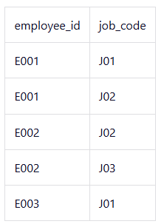
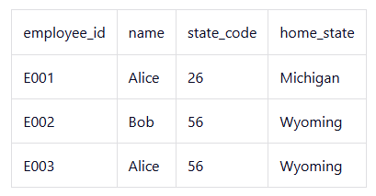

Example of Second Normal Form (2NF)
Employee roll Table
Employee Table
Job Table

Slide 13
Third Normal Form
A relation is said to be in third normal form, if we did not have any transitive dependency for non-prime attributes.
The basic condition with the Third Normal Form is that, the relation must be in Second Normal Form.

Slide 14
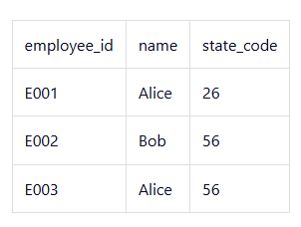

Example of Third Normal Form (3NF)
Employee roll Table
Employee Table
Job Table
State Table

